Slide 1
An introduction to the novel: Forbidden City
Written By: William Bell

Slide 2
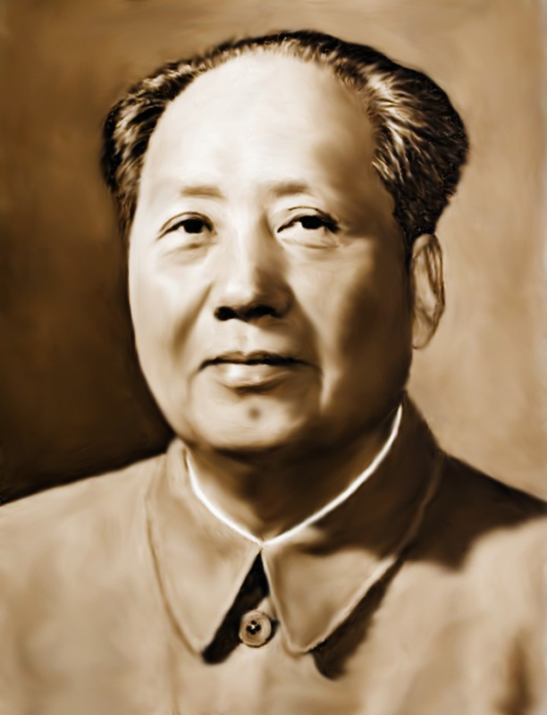
A Bit of Chinese History
Mao Zedong was the leader of the Communist Party of China since 1949.
He exerted power by instilling fear into the people. He used forms of torture, used the army against the population (Guerilla Warfare), and would execute suspected enemies.
There was a military retreat undertaken by the Red Army of the Chinese Communist Party to run away from Chinese Nationalist Party army. The Long March, was a military retreat to the West, that counted over 370 days and 12, 500 km.
The Great Leap Forward was an economic plan for agriculture. It affected farmers, peasant and led to mass starvation in rural areas. Peasants had to work on iron and steel production. Livestock and farm implements were brought under collective ownership.
Mao later died of a heart attack in 1976.

Slide 3
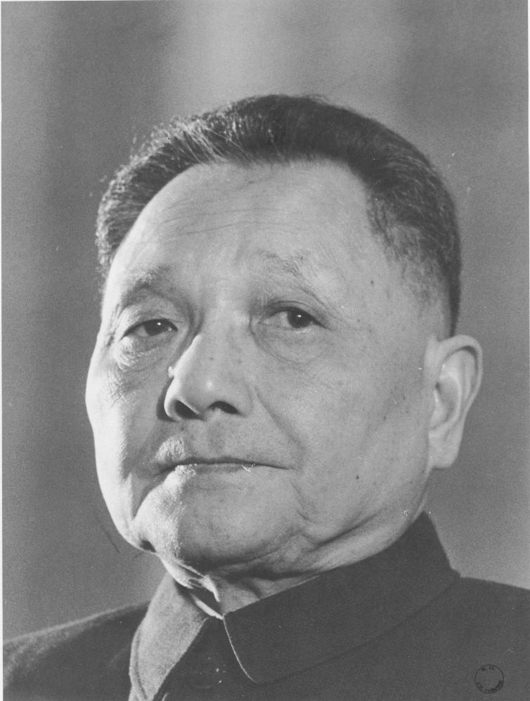
Deng Xiaoping
Deng Xiaoping was the leader of China after Mao.
He improved the country’s economic growth by increasing production and farmers kept their own profit.
He had much better relations with Western countries and Japan.
He was a dictator and wanted to keep China’s traditions. A traditional, but prosperous country, without defiance.

Slide 4
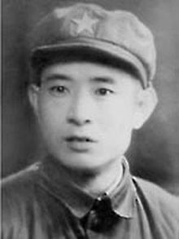
Hu Yaobang
Hu Yaobang was Party Chairman in 1981 and was also Secretary of the Communist Party of China.
Deng forced Hu to resign after a series of student demonstrations in late 1986.
Hu’s tolerance of and his empathetic attitude towards China’s liberal intelligentsia who were pushing for more political freedom and reform, made him an enemy according to Deng.

Slide 5
Tiananmen Square
The protests in Tiananmen Square were sparked by the death of Hu Yaobang.
On April 22, 1989, 50, 000 students marched to Tiananmen Square to participate in Hu’s funeral, while delivering a letter of petition to Premier Li Peng. Public mourning began on the streets of Beijing; centered on the Monument to the People’s Heroes.
On June 4th, 1989, students had begun protesting their rights. They wanted democratic freedom. In short, Martial Law was proclaimed. They had been labelled as enemies. https://www.youtube.com/watch?v=kMKvxJ-Js3A
Hu’s ideas of freedom of speech and freedom of press in 1986 greatly influenced the students participating in the protests.

Slide 6
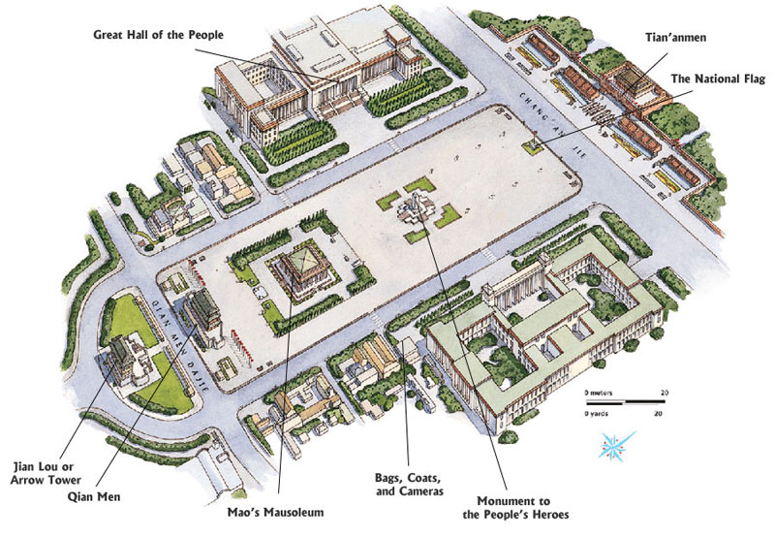
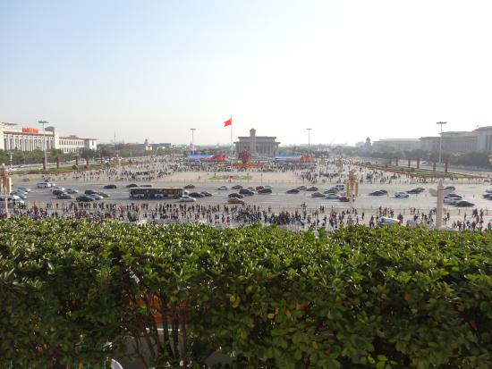
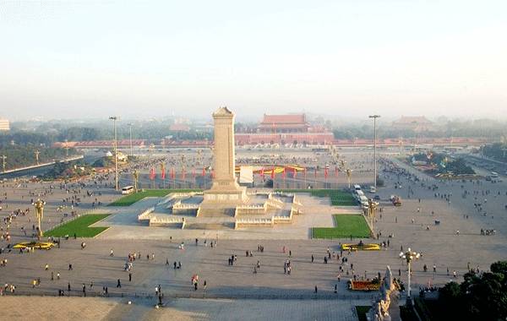

Slide 7
Basic Human Right: Freedoms All People Should Have.
Effects of having rights denied
Rights
Others make decisions that affect our lives.
Otherwise, we would not have the necessary skills to get a job and make a living.
Inability to get a job, an education or access to other rights based on your background.
You would need costly private insurance or do without the necessary care you need.
Exposed to contaminated water and food.
You could not express your concerns, oppositions or even write a letter to the editor.
Inability to practice your religion or speak your mother tongue. If you do, it would be in fear.
Your parents would choose your partner.
Could not live with or marry a partner of your own sex.
The government could have you sterilized because of gene defects.
Right to vote
Right to education
Right to equality
Right to proper health and medical attention
Right to clean water and proper food
Freedom of speech
Freedom of language and religion
Freedom to marry
Right to one’s own sexuality
Right to reproduce

